Slide 1
Sorting

Slide 2
Part 1
You are giving a list lst of n numbers. If you are given an index i for 0 < i < n.
We find out which of the two numbers lst[i-1] and lst[i] is bigger.
And, we will swap the bigger one to the right, such that lst[i] > lst[i-1]. If they are equal, just let it be.

Slide 3
BubbleSort
8 | 2 | 4 | 9 | 3 | 6
Example:

Slide 4
BubbleSort
8 | 2 | 4 | 9 | 3 | 6
2 | 8 | 4 | 9 | 3 | 6
Example:

Slide 5
BubbleSort
8 | 2 | 4 | 9 | 3 | 6
2 | 8 | 4 | 9 | 3 | 6
2 | 4 | 8 | 9 | 3 | 6
Example:

Slide 6
BubbleSort
8 | 2 | 4 | 9 | 3 | 6
2 | 8 | 4 | 9 | 3 | 6
2 | 4 | 8 | 9 | 3 | 6
2 | 4 | 8 | 9 | 3 | 6
Example:

Slide 7
BubbleSort
8 | 2 | 4 | 9 | 3 | 6
2 | 8 | 4 | 9 | 3 | 6
2 | 4 | 8 | 9 | 3 | 6
2 | 4 | 8 | 9 | 3 | 6
2 | 4 | 8 | 3 | 9 | 6
Example:

Slide 8
BubbleSort
8 | 2 | 4 | 9 | 3 | 6
2 | 8 | 4 | 9 | 3 | 6
2 | 4 | 8 | 9 | 3 | 6
2 | 4 | 8 | 9 | 3 | 6
2 | 4 | 8 | 3 | 9 | 6
2 | 4 | 8 | 3 | 6 | 9
Example:

Slide 9
BubbleSort
8 | 2 | 4 | 9 | 3 | 6
2 | 8 | 4 | 9 | 3 | 6
2 | 4 | 8 | 9 | 3 | 6
2 | 4 | 8 | 9 | 3 | 6
2 | 4 | 8 | 3 | 9 | 6
2 | 4 | 8 | 3 | 6 | 9
Example:

Slide 10
Another n-1 round
2 | 4 | 8 | 3 | 6 | 9
2 | 4 | 8 | 3 | 6 | 9
2 | 4 | 8 | 3 | 6 | 9
2 | 4 | 3 | 8 | 6 | 9
2 | 4 | 3 | 6 | 8 | 9
2 | 4 | 3 | 6 | 8 | 9
Example:

Slide 11
Another n-1 round
2 | 4 | 3 | 6 | 8 | 9
2 | 4 | 3 | 6 | 8 | 9
2 | 3 | 4 | 6 | 8 | 9
2 | 3 | 4 | 6 | 8 | 9
2 | 3 | 4 | 6 | 8 | 9
2 | 3 | 4 | 6 | 8 | 9
Example:

Slide 12
Another n-1 round
2 | 3 | 4 | 6 | 8 | 9
2 | 3 | 4 | 6 | 8 | 9
2 | 3 | 4 | 6 | 8 | 9
2 | 3 | 4 | 6 | 8 | 9
2 | 3 | 4 | 6 | 8 | 9
2 | 3 | 4 | 6 | 8 | 9
Example:

Slide 13
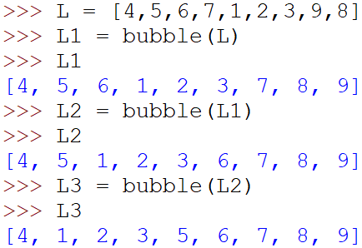
Part 1
For one round of n-1 bubble we have
And a few rounds more
How many rounds do we need to sort the whole list?

Slide 14
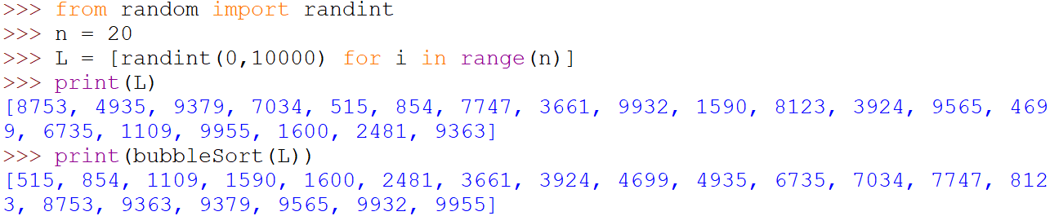
Bubble Sort
Write a function bubbleSort(lst) to return a list that is sorted. Here is some sample output, in which, you should be able to change n to a larger number and the sorting still work.

Slide 15
Final thoughts
Do you really need to:
Apply so many times?
When can we end?
For the whole list?

Slide 16
Searching
Bisection method

Slide 17
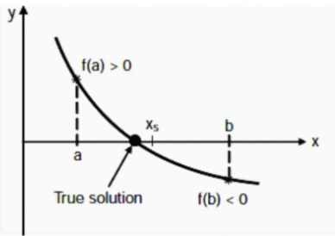
Bisection Method
The bisection method in mathematics is a root-finding method that repeatedly bisects an interval and then selects a subinterval in which a root must lie for further processing. Given a function f(x), you want to solve for x when f(x) = 0.

Slide 18
Algorithm
In this question, we assume that the function f is continuous. And you are given two numbers a and b such that f(a) > 0 and f(b) < 0. So you repeat the following
Compute x_{s} = (a + b) /2
If f(x_{s}) < 0 then the solution lies on the of x_{s}. So, b = x_{s}.
Otherwise, a = x_{s}.
Repeat these until the absolute value of f(x_{s}) is smaller than a constant ‘error’

Slide 19
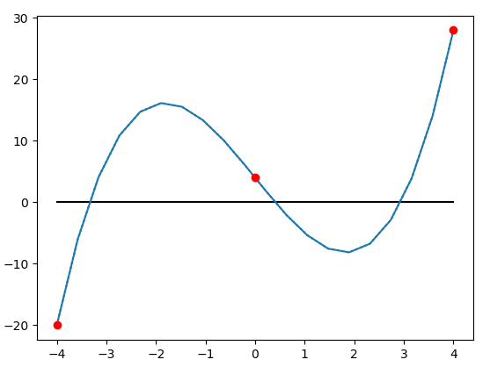
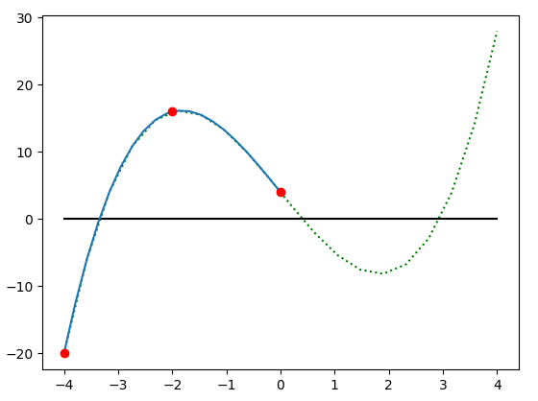
“a” “mid” and “b”
Replace b by mid

Slide 20
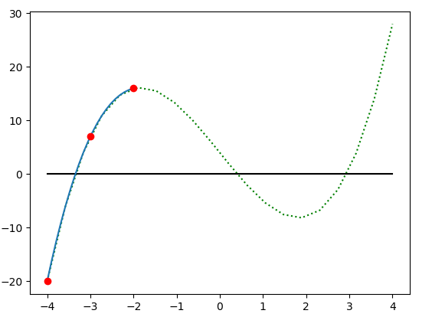
“a” “mid” and “b”
Replace b by mid

Slide 21
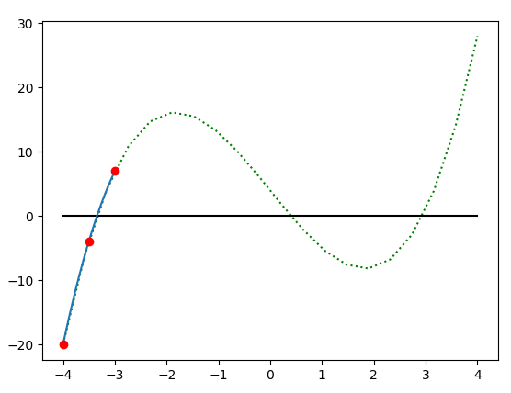
“a” “mid” and “b”
Replace b by mid

Slide 22
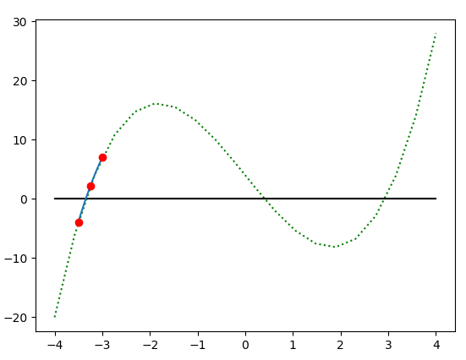
“a” “mid” and “b”
Replace a by mid

Slide 23
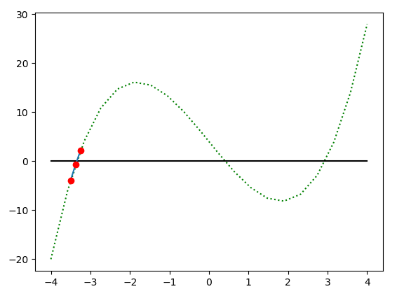
“a” “mid” and “b”
Replace b by mid

Slide 24
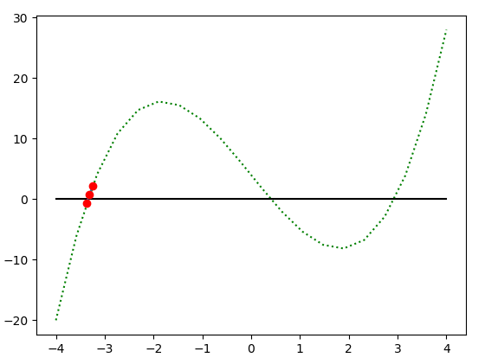
“a” “mid” and “b”
After more iterations, x = -3.34596…

Slide 25
Rest of the Tutorial
Try to implement bisection(start,end,f) to solve the problem
For the two given function f and g, you should be able to solve f without “reversing”
Suggestion
For every iteration, print out:
a, mid , b
f(a), f(mid), f(b)
And the decision that which one among a or b that is to be replaced by mid

Slide 26
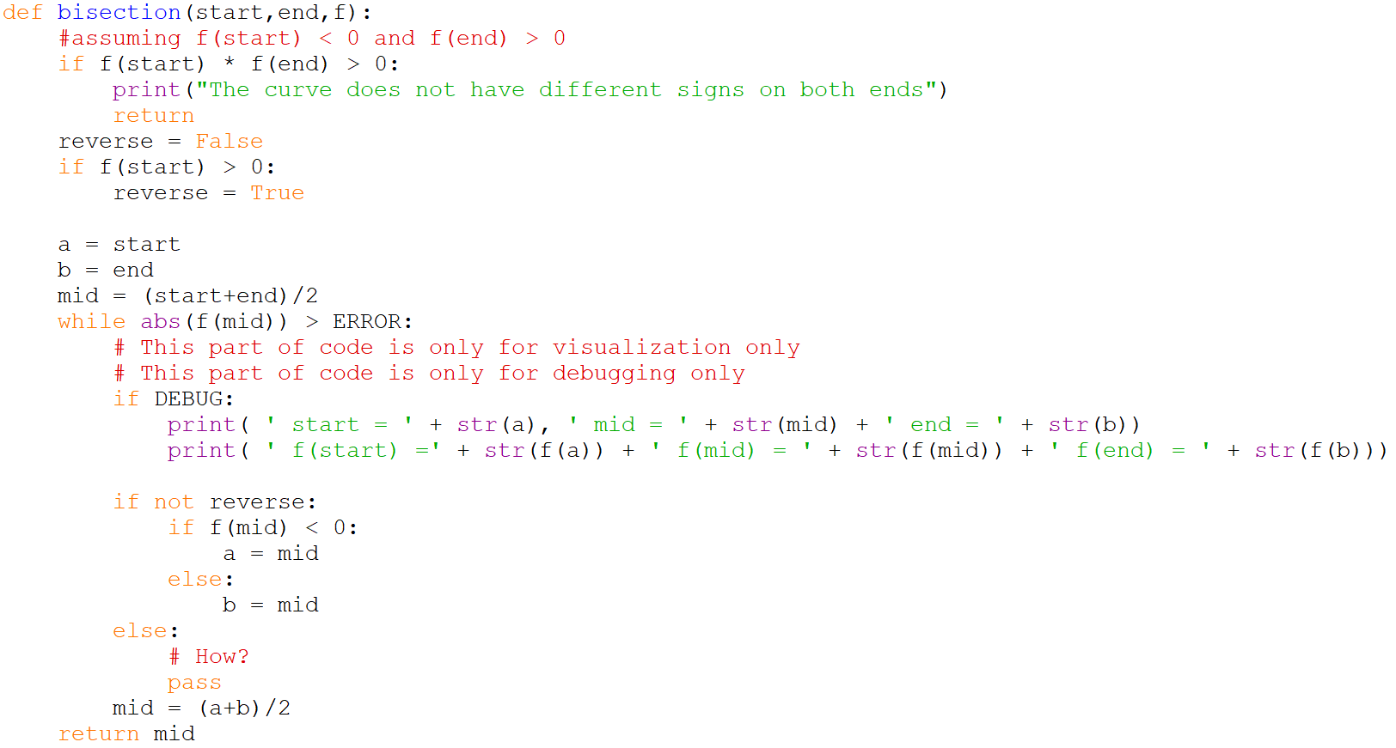

Slide 27

Extra qSort
You are given a list lst of n numbers. To simplify the problem, we assume we have no duplicate element in the list. (However, even so, it is not difficult to solve.)
We will pick any element of the list, say x.
And for the rest of the element in lst, we will separate them into two lists, one list lsta contains all the element smaller than x, and lstb, otherwise. Let’s give a name to this functionality as “partition”.

Slide 28
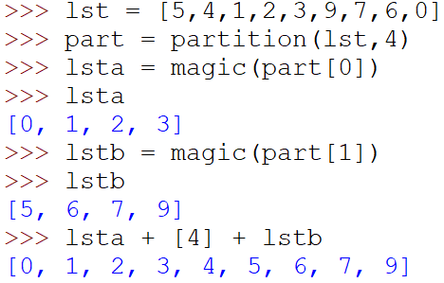
Magic
Then we apply some “magic” to lsta and lstb such that they are sorted after the magic.
Finally, we output the list lsta + [x] + lstb.

Slide 29
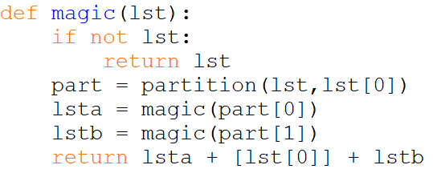
Magic
Then we apply some “magic” to lsta and lstb such that they are sorted after the magic.
Finally, we output the list lsta + [x] + lstb.
You can finish the function partition in order to finish this magic

